Slide 1


Spam Filtering Problem
Enron corpus analysis
Shizhi Chen-10307389

Slide 2
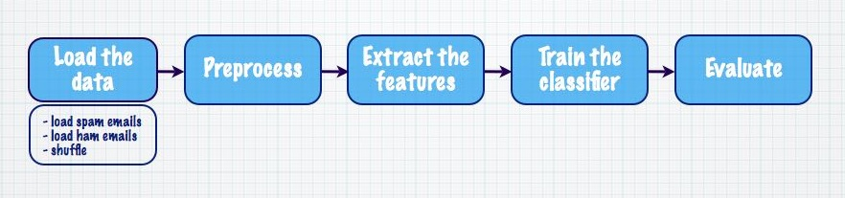
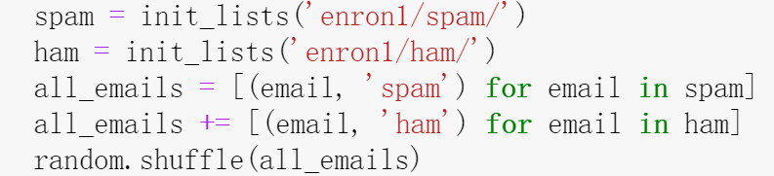
5 Steps of Binary Classification
“Spam” or “Ham” ?
Step 1: Loading the data
Read the spam and ham txt files separate
Store them as a list of two-place tuples (email content, label )

Slide 3
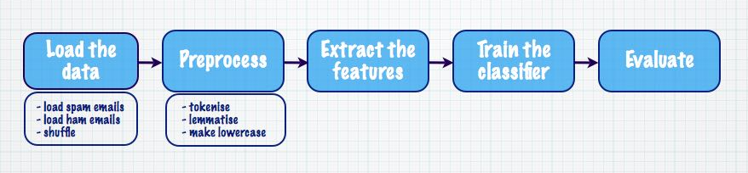
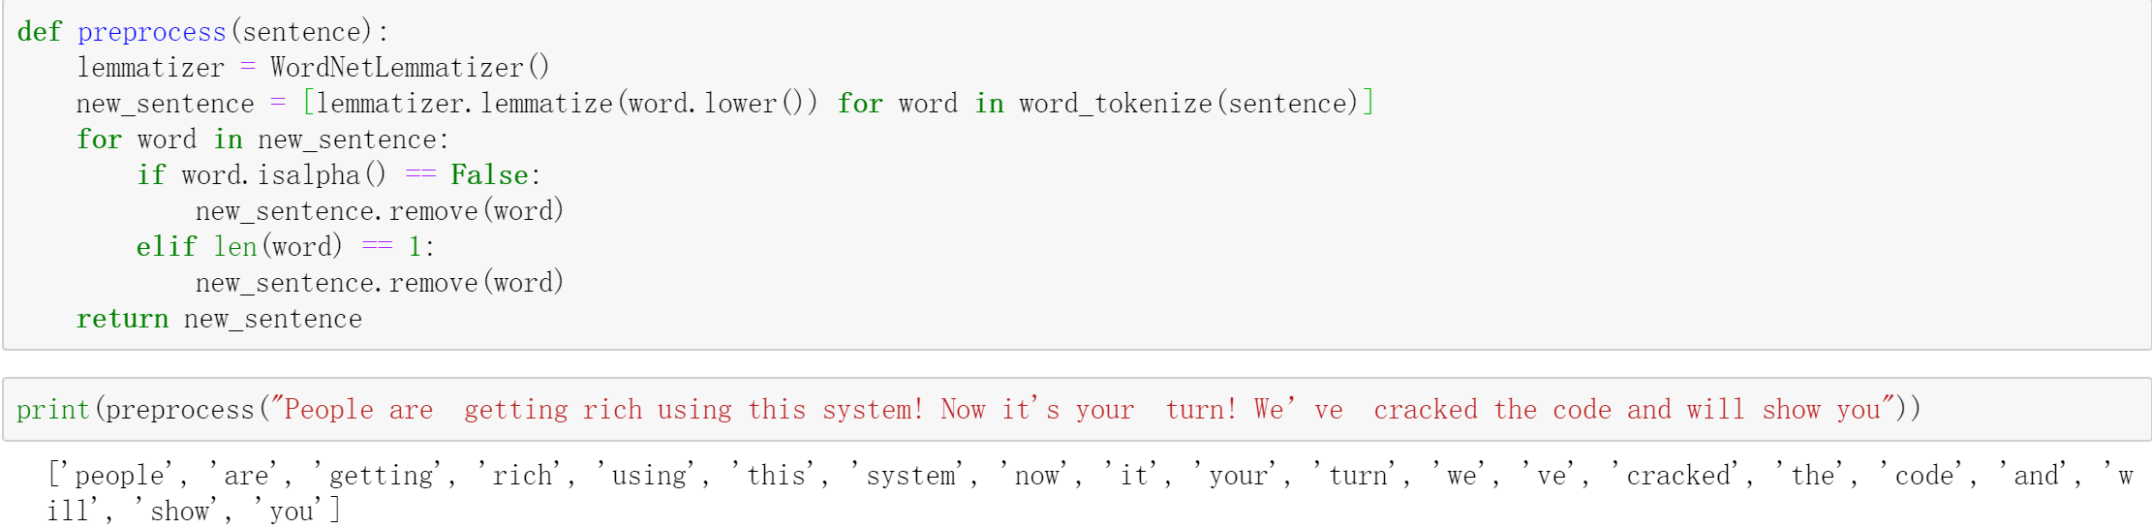
Step 2: Preprocessing the data
Example: (‘People are getting rich using this system! Now it’s your turn! We’ve cracked the code and will show you…’, ‘spam’) (spam email #046 in enron1/)

Slide 4
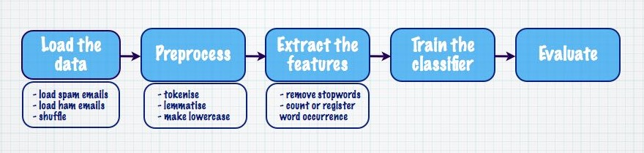
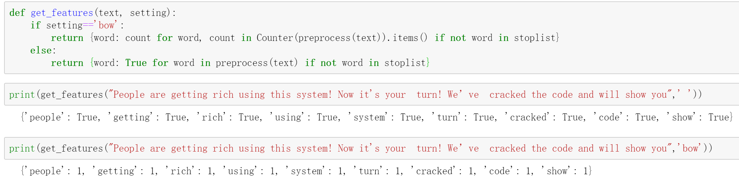
Step 3: Extracting the features
Features
example:

Slide 5
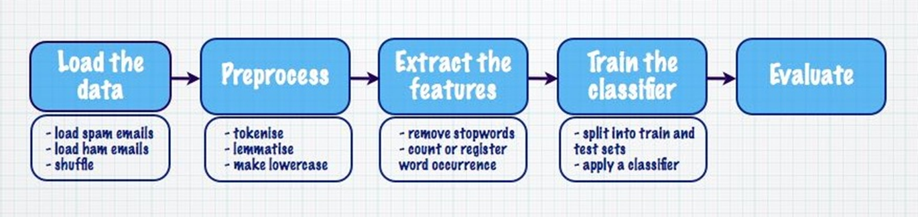
Step 4: Training a classifier
Split dataset into 80% train sets and 20% test sets
(4137 emails and 1035 emails)
Naive Bayes Classifier:
Spam !
Prior probability: P(spam) and P(ham)
Conditional probability: P(words|spam) and P(words|ham)

Slide 6
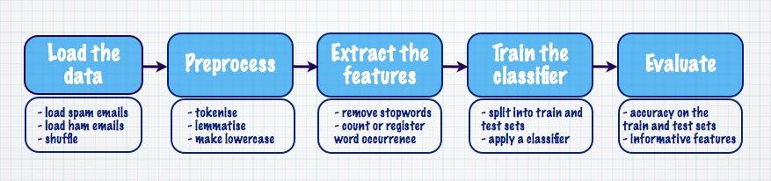

Step5: Evaluating classifier performance
Confusion Matrix:
Naive Bayes Classifier | Ham | Spam
Ham | 296 | 35
Spam | 12 | 692
308 Ham 727 Spam
Accuracy on the test set $≈0.9546$

Slide 7
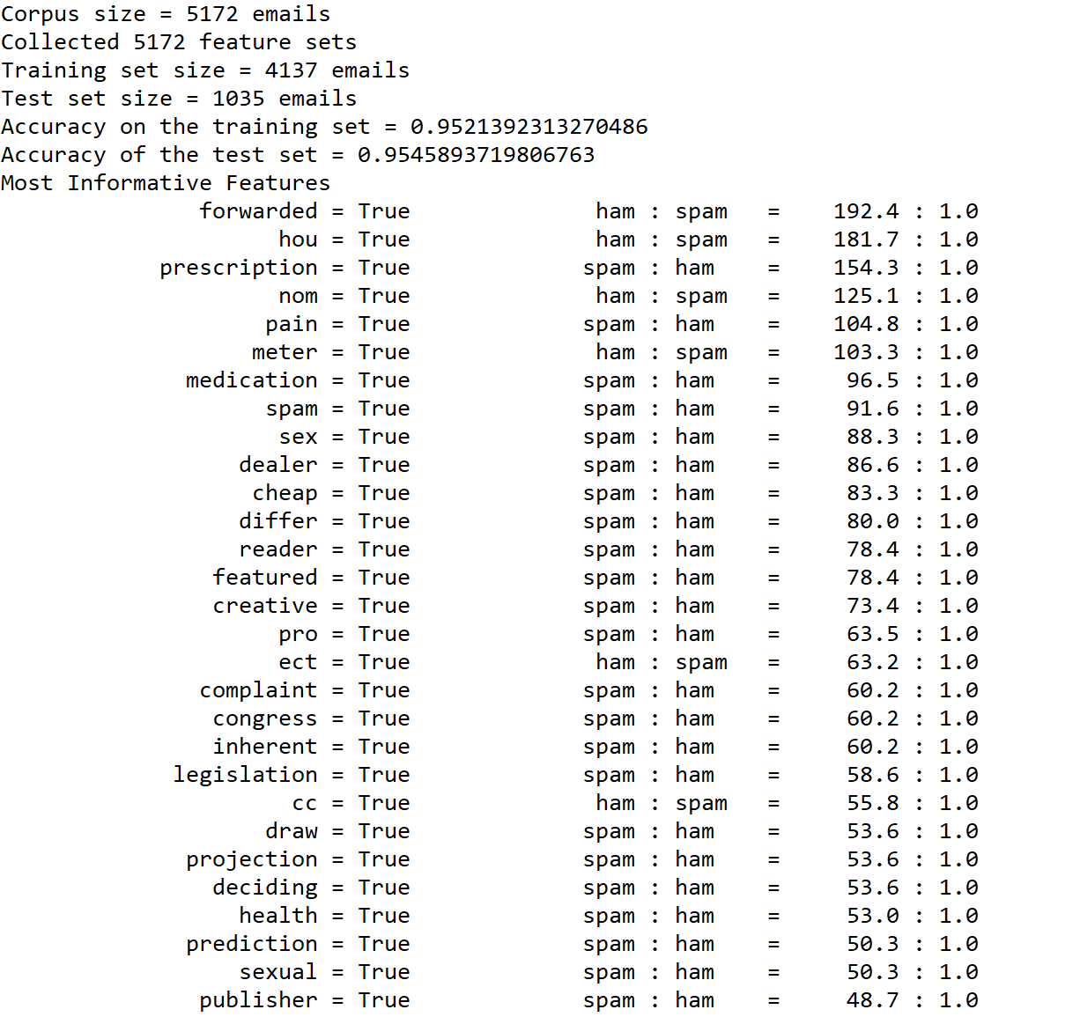
Assessing and Improvement
Number of training data
Improve the features by eliminating
unimportant words (can be manually)
Different machine learning techniques,
such as SVM, Logistics Regression, KNN

Slide 8
Thank you ! Question Time

